Slide 1
CS 401 Artificial Intelligence
FAST-NU
Dr. Kashif Zafar
Lecture 13
November 23, 2021
Department of Computer Science
National University of Computers & Emerging Sciences
Lahore.

Slide 2
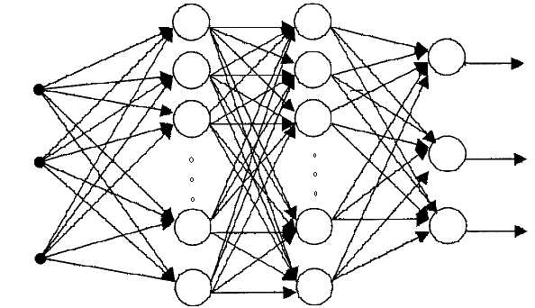
NEURAL NETWORKS
Multi Layer Perceptron: Architecture & Forward Pass
Input Units Hidden Units Output Units

Slide 3
NEURAL NETWORKS
Backpropagation Algorithm
Set up the architecture & initialize the weights of the network
Apply the training pairs (input-output vectors) from the training set, one by one
For each training pair, calculate the output of the network
Calculate the error between actual output & desired output
Propagate the error backwards & adjust the weights in such a way that minimizes the error
Repeat the above steps for each pair in the training set until the error for the set is lower than the required minimum error

Slide 4
NEURAL NETWORKS
Multi Layer Perceptron:
Training by Backpropagation Algorithm
Let E = accumulative error over a data set. It is a function of network weights
E = ∑_{training samples}∑_{j} (d_{j} – O_{j})²
d_{j} is the desired output of node j and O_{j} is the actual output
The error is squared so that the positive and negative errors may not cancel each other out during summation

Slide 5
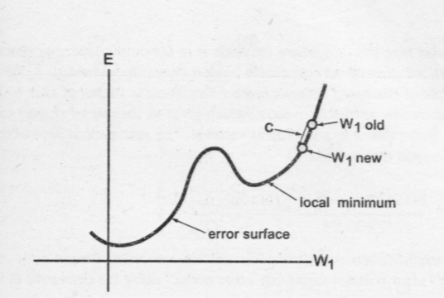
NEURAL NETWORKS
Multi Layer Perceptron:
Training by Backpropagation Algorithm
Each weight configuration can be represented by a point on an error surface

Slide 6
NEURAL NETWORKS
Multi Layer Perceptron: Training
Starting from a random weight configuration, we want our training algorithm to move in the direction where error is reduced more rapidly
Delta rule attempts to minimize the local error and uses the derivative of the error to find the slope of the error space in the region local to a particular point

Slide 7
NEURAL NETWORKS
Multi Layer Perceptron: Training
Delta rule uses gradient descent:
Δw_{ij} = -c (∂Error/ ∂w_{ij})
Let current weight be 4
Then ∂Error/ ∂w_{ij} = 9.5 – 9.0/5 – 3 = 0.25
The new weight will be w_{new} = w_{old} –c*0.25 = 3.875
if c = 0.5 (c is the learning rate)
If the error curve had been downward, then
∂Error/ ∂w_{ij} = 9.0 – 9.5/5 – 3 = -0.25
The new weight will be
w_{new} = w_{old} –c*-0.25 = 4.125

Slide 8
NEURAL NETWORKS
Multi Layer Perceptron: Training
Delta rule:
Δw_{ij} = -c (∂Error/ ∂w_{ij})
If the learning constant “c” is large (more than 0.5), weights move quickly to optimal value but there is a risk of overshooting the minimum or oscillation around optimum weights
If “c” is small, the training is less prone to these problems but system does not learn quickly; also the algorithm may get stuck in local minima

Slide 9
NEURAL NETWORKS
Multi Layer Perceptron: Training
The weights are updated incrementally, following the presentation of each training example
This corresponds to a stochastic approximation to gradient descent
To obtain the true gradient of Error, one would consider all of the training examples before altering the weight values
The stochastic approximation avoids costly computations per weight update

Slide 10
NEURAL NETWORKS
Multi Layer Perceptron: Training of Output Layer Weights
Randomly set the weights
Present first training input vector to the network
Calculate the outputs of all neurons
The inputs to the last layer of neurons would be the output of 2nd last layer
We calculate the Error of all the output neurons and now we wish to change the weights of an output neuron “j” so that its error reduces
We use Delta rule:
Δw_{ij} = -c (∂Error/ ∂w_{ij})

Slide 11
NEURAL NETWORKS
Multi Layer Perceptron: Training of Output Layer Weights
The equation ∂Error/ ∂w_{ij} means that we want the rate of change of network error as a function of the change in one of weights of an output node j
Since for our current training sample
Error = ∑_{j} (d_{j} - O_{j})²
Where O_{j} is itself a function of other variables (including w_{ij}), therefore we use partial derivatives (this gives us the rate of change of a multi-variable function w.r.t a particular variable)

Slide 12
NEURAL NETWORKS
Multi Layer Perceptron: Training of Output Layer Weights
To calculate this quantity we use chain rule
The Error is only indirectly dependent on w_{ij}, but it is directly dependent on variable O_{j}
∂Error/ ∂w_{ij} = (∂Error/ ∂O_{j}) . (∂ O_{j} / ∂w_{ij})
∂Error/ ∂O_{j} = rate of change of error w.r.t output of node j
Now ∂Error/ ∂O_{j} = ∑_{j} (d_{j} - O_{j})² /∂O_{j} = -2(d_{j} - O_{j})
For ∂ O_{j} / ∂w_{ij} we have (∂ O_{j} / ∂act_{j}) (∂ act_{j} / ∂w_{ij})
(∂ O_{j} / ∂act_{j}) = (∂ f(act)_{j} / ∂act_{j}) = f’(act_{j})
(∂ act_{j} / ∂w_{ij}) = (∂ ∑_{i} x_{i}w_{ij}/ ∂w_{ij}) = x_{i}
Hence Δw_{ij} = -c (∂Error/ ∂w_{ij}) = -c[-(d_{j} - O_{j}) . f’(act_{j}) . x_{i}]

Slide 13
NEURAL NETWORKS
Multi Layer Perceptron: Training of Hidden Layer Weights
The formula for hidden layer weights update is different
because
the training examples provide target values only for the network outputs, and no target values are directly available to indicate the error of hidden unit’s values

Slide 14
NEURAL NETWORKS
Multi Layer Perceptron: Training of Hidden Layer Weights
j
w_{ki}
k
i
Hidden layer
Output layer

Slide 15
NEURAL NETWORKS
Multi Layer Perceptron: Training of Hidden Layer Weights
Adjustment of k^{th} weight of node “i”
Δw_{ki} = -c (∂Error/ ∂w_{ki})
Since Error is not a direct function of weight w_{ki}, therefore we use chain rule
∂Error/ ∂w_{ki} = (∂Error/ ∂O_{i}) . (∂ O_{i} / ∂w_{ki})
∂Error/ ∂O_{i} = rate of change of error w.r.t output of node i
= ∂ ∑_{j} Error_{j}/ ∂O_{i}
k
w_{ki}
i

Slide 16
NEURAL NETWORKS
Multi Layer Perceptron: Training of Hidden Layer Weights
Since each Error_{j} is independent
of other Error_{j}
(each has its own independent weight set)
Hence
∂ ∑_{j} Error_{j}/ ∂O_{i} = ∑_{j} (∂ Error_{j}/ ∂O_{i} )
Again use chain rule we have
= ∑_{j} [(∂ Error_{j}/ ∂act_{j}) . (∂act_{j} / ∂O_{i})]
k
w_{ki}
i

Slide 17
NEURAL NETWORKS
Multi Layer Perceptron: Training of Hidden Layer Weights
∂ ∑_{j} Error_{j}/ ∂O_{i} = ∑_{j} [(∂ Error_{j}/ ∂act_{j}) . (∂act_{j} / ∂O_{i})]
∂ Error_{j}/ ∂act_{j} = (∂ Error_{j}/ ∂O_{j}) (∂ O_{j}/ ∂act_{j})
where ∂ Error_{j}/ ∂O_{j} = ∂ (d_{j} – O_{j})²/ ∂O_{j} = -2(d_{j} - O_{j})
and ∂ O_{j}/ ∂act_{j} = ∂ f(act_{j})/ ∂act_{j} = f’(act_{j})
(∂act_{j} / ∂O_{i}) = (∂ ∑ x_{i}w_{ij} / ∂O_{i})
Since O_{i} = x_{i}
hence ∂act_{j} / ∂O_{i} = w_{ij}

Slide 18
NEURAL NETWORKS
Multi Layer Perceptron: Training of Hidden Layer Weights
So we started with
∂Error/ ∂w_{ki} = (∂Error/ ∂O_{i}) . (∂ O_{i} / ∂w_{ki})
and we have determined the first part
For the 2nd part
∂ O_{i} / ∂w_{ki} = (∂ O_{i} / ∂act_{i})(∂ act_{i} / ∂w_{ki})
(∂ act_{i} / ∂w_{ki}) = (∂ ∑_{k} x_{k}w_{ki}/ ∂w_{ki}) = x_{k}
(∂ O_{i} / ∂act_{i}) = (∂ f(act)_{i} / ∂act_{i}) = f’(act)_{i}
Hence Δw_{ki} = -c (∂Error/ ∂w_{ki})
= -c[-2∑_{j} {(d_{j} - O_{j}) f’(act_{j}) w_{ij} }f’(act)_{i} x_{k}]
k
w_{ki}
i

Slide 19
NEURAL NETWORKS
Multi Layer Perceptron: Training
A typical activation function is logistic function (which is a type of sigmoidal function)
f(act) = 1/(1 + e^{-λact})
If value of λ (squashing parameter) is large we have a unit step function, if it is small we have almost a straight line between two saturation limits
f’(act) = f(act)(1 – f(act))

Slide 20
NEURAL NETWORKS
Multi Layer Perceptron: Training
This approach is called “gradient descent learning”
Requirement of this approach is that the activation function must be differentiable (i.e. continuous)
The number of input and output neurons are fixed
But the selection of number of hidden layers and the number of neurons in the hidden layers is done by trial and error

Slide 21
NEURAL NETWORKS
Multi Layer Perceptron: Training
The gradient descent is not guaranteed to converge to the global optimum
The algorithm we have discussed is the incremental gradient descent (or stochastic gradient descent) version of the Backpropagation

Slide 22
NEURAL NETWORKS
Multi Layer Perceptron: Face Recognition Example
Images of 20 different people
32 images per person
With varying expressions (happy, sad, angry, neutral)
and
looking in various directions (left, right, straight, up)
and
with and without sunglasses
Grayscale images (intensity between 0 to 255) and
size (resolution) of 120 x 128 pixels

Slide 23
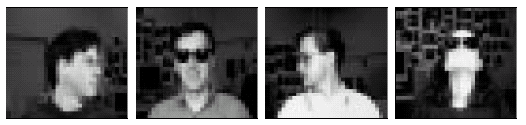

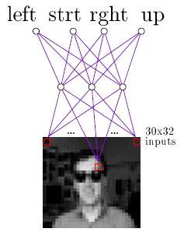
NEURAL NETWORKS
Multi Layer Perceptron: Face Recognition Example

Slide 24
NEURAL NETWORKS
Multi Layer Perceptron: Face Recognition Example
An ANN can be trained on any one of a variety of target functions using this image data, e.g.
- identity of a person
- direction in which person is looking
- gender of the person
- whether or not they are wearing sunglasses

Slide 25
NEURAL NETWORKS
Multi Layer Perceptron: Face Recognition Example
Design Choices:
Separate the data into
training (260 images) and test sets (364 images)
Input Encoding
- 30 x 32 pixel image
- A coarse resolution of the 120 x 128 pixel image
- Every 4 x 4 pixels are replaced by their mean value
- The pixel intensity is linearly scaled from 0 to 1 so that inputs, hidden units and output units have the same range

Slide 26
NEURAL NETWORKS
Multi Layer Perceptron: Face Recognition Example
Design Choices:
Output Encoding
- Learning Task: Direction in which person is looking
- Only one neuron could have been used with outputs
0.2, 0.4, 0.6, and 0.8 to encode the four possible values
- But we use 4 output neurons, so that measure of confidence in the ANN’s decision can be obtained
- Output vector:
1 for true & 0 for false; e.g. [1, 0, 0, 0]

Slide 27
NEURAL NETWORKS
Multi Layer Perceptron: Face Recognition Example
Design Choices:
Network Structure
- How many Layers?
Usually one hidden layer is enough
- How many units in the hidden layer
More than necessary units result in over-fitting
Less units result in failure of training
Trial & error: Start with a number and prune the units with the help of a cross-validation set

Slide 28
Reading Assignment & References
Chapter 4 of Tom M. Mitchell “Machine Learning”
http://www-2.cs.cmu.edu/afs/cs/project/ai-repository/
ai/areas/neural/systems/nevprop/np.c

Slide 29
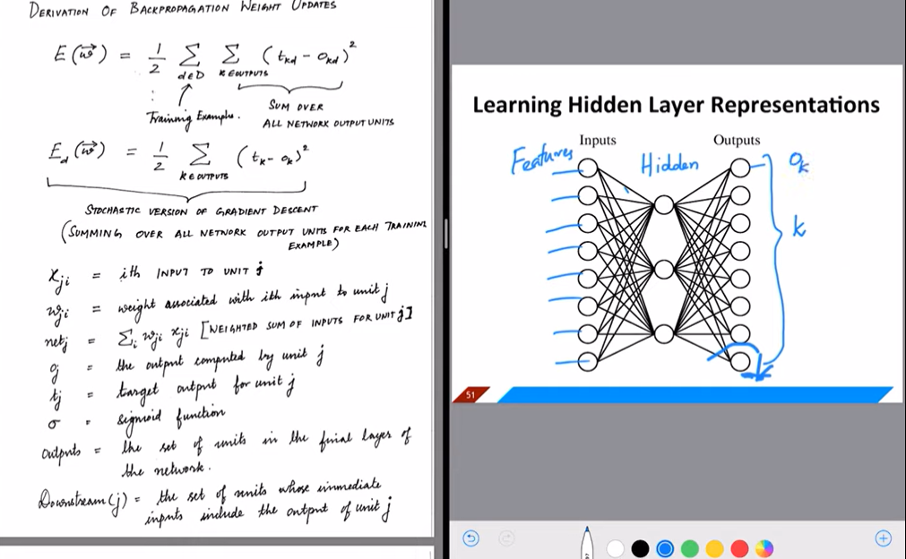

Slide 30
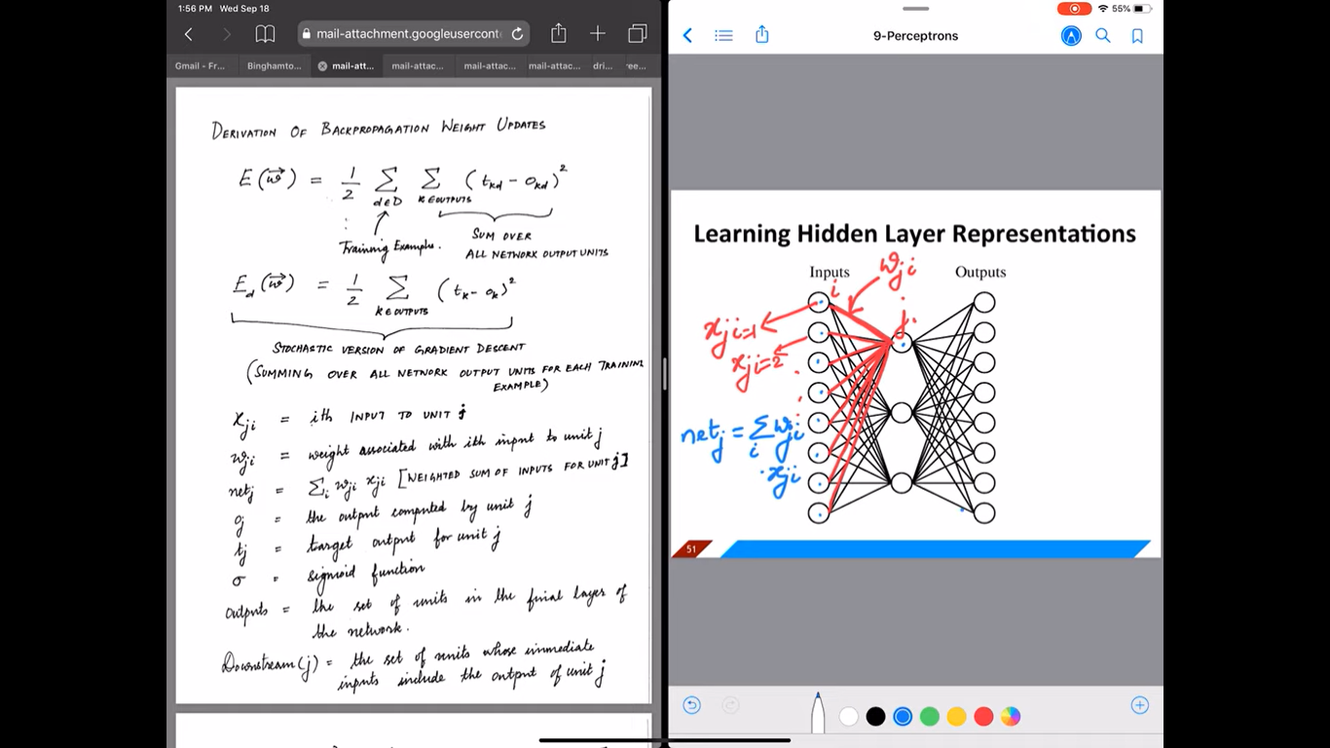

Slide 31
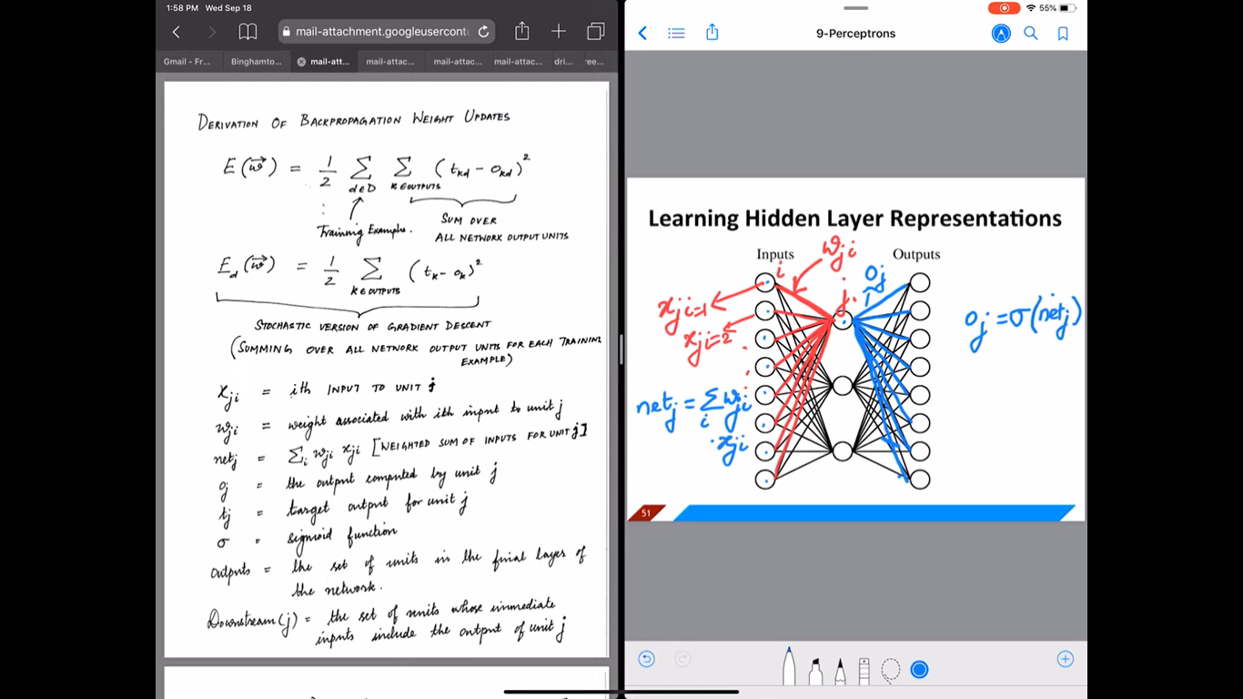

Slide 32
